Slide 1


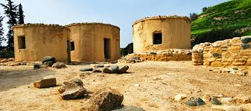

Neolithic settlements in Cyprus
TEAM 1
GREEN SEEDS
Research project by the students of AI2:
Dimitris Iakovou
Petros Themistocleous
Raphael Patsalidi

Slide 2
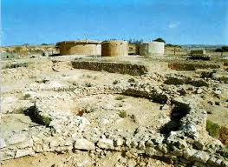
Neolithic settlements of Cyprus
So far, the earliest Neolithic villages in Cyprus date between 8300-8400 BC.
This culture is called the Cypriot Neolithic pre-ceramic culture. Pre-ceramic, because the techniques of ceramics were not yet known.
This culture is represented in the example of Choirokoitia and in about twenty other settlements.

Slide 3
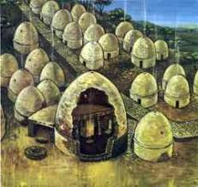
Choirokoitia
The Neolithic settlement of Choirokoitia has been included in the list of UNESCO World Heritage Sites since 1998 and is located near the homonymous village in the province of Larnaca.
It is a settlement of the Neolithic period (7500-5200 BC) and is preserved in a better condition than most settlements of the same period, not only in Cyprus but also in the entire Eastern Mediterranean.
The settlement and the phases it underwent represent the history of the Neolithic period in Cyprus and provide valuable information about the spread of the Neolithic civilization in the area.

Slide 4
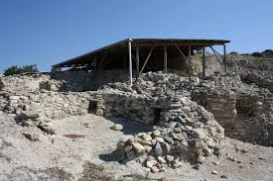
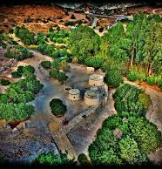
Location
The settlement is built on a hill located on the west bank of the river Maroni, at a distance of 6 km from the sea. It consists of a long stone building with a length of 185 meters.
The specific building, which was discovered by Porfirios Dikeos, a Cypriot archaeologist, was considered by him “as the main road”.
At a later stage, it was documented that the specific building was the wall of the settlement.
Excavation and hydrogeomorphological research in Choirokoitia documents incidents of floods.
During the early phase of the settlement, trees such as olives and figs thrive. In the later period, the presence of certain trees decreases, while the presence of others increase significantly, such as pine.

Slide 5
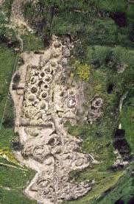
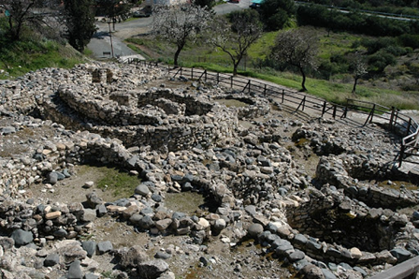
Choice of location- creation of settlements
All of the above show that:
The people created their settlements near seas and rivers, to have access to drinking water and to be able to fish.
They built their homes on hills to be safe and secure their personal belongings.

Slide 6
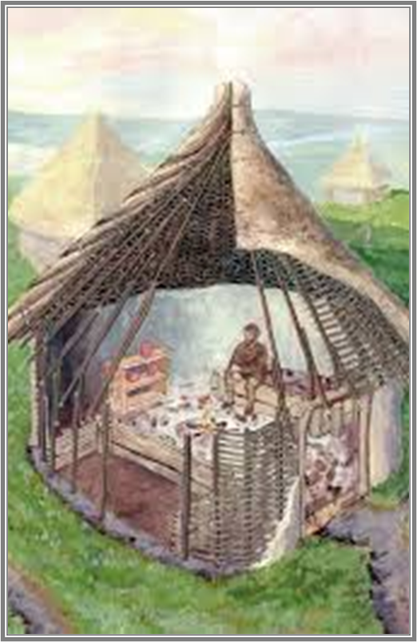
Choice of location
Consequently, the small social groups of the Neolithic Cypriots had built their settlements in naturally fortified places, for example on the tops of hills (Choirokoitia), or on rocky shores (Apostolos Andreas - Kastros), or even in areas surrounded by the sea (Petra tou Limniti). Such posts appear to have provided adequate security and protection.

Slide 7

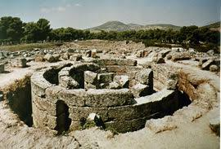
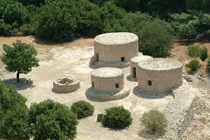
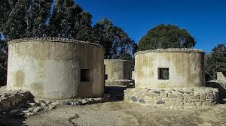

Web sources
Choirokoitia Neolithic Settlement, Larnaca / Αρχαιολογικός Χώρος Χοιροκοιτίας, Λάρνακα – YouTube
(3) Αρχιτεκτονική της Νεολιθικής Χοιροκοιτίας – YouTube Architecture in Choirokoitia

Slide 8
Thank you !
☺

Slide 9
GREEN SEEDS
TEAM 2 ☺
Research project:
the tools in the Neolithic settlements of Cyprus

Slide 10
TOOLS
Hand mills
Grinders
Bowls
Axes
Blades
Knife blades
Bone needles
Arrows
Bats
Fish and seashells

Slide 11
The material they used for the tools
Flint, a form of rock.
Limestone, another form of rock.
Animal bones.
Wood.

Slide 12
Where did they find the materials?
They were found in nature and were used to search for food or make other items. Specifically, tools were made for harvesting cereals, cutting reeds, processing wood and scraping the skin of animals. Most bone tools were used to make objects, including fine sewing threads and drilling tools.

Slide 13
Links
https://mail.google.com/mail/u/0?ui=2&ik=3d9dc7c1db&attid=0.1&permmsgid=msg-f:1697112892729164290&th=178d5b2f2adb8202&view=att&disp=safe&realattid=f_kniwx4yj0
https://www.youtube.com/watch?v=TNtN-Np3Uuw

Slide 14
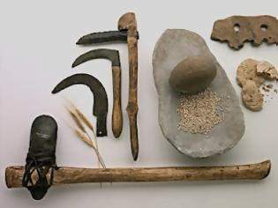
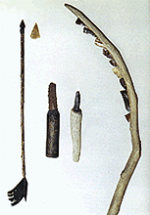
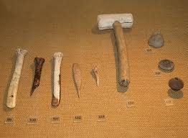

Slide 15
The students who worked on the project:
Angelos Vintra,
Angelos Erodotou,
Christodoulos Poliviou!
Thank you ☺

Slide 16

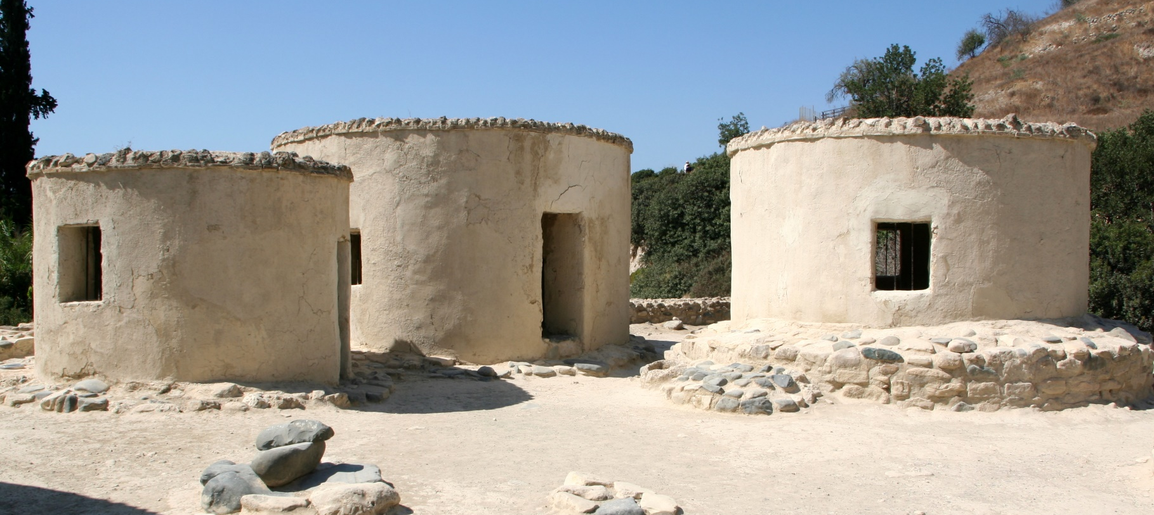
TEAM 3
CHOIROKOITIA
Environment, Art, Tools
CLASS Α2: panagiotis, elias, dimitris, ieronimos, constantinos.

Slide 17

Choirokitia - Environment
Regarding climate and the environment, scientific findings show that in Europe and the Middle East there was a significant climate change around 6200 BC. The excavation and research in Choirokoitia documents the existence of several episodes of waterfalls.
After this period, the climatic conditions seem to stabilize into mild Mediterranean climate. Carbohydrate studies provide a roughly similar picture.
During the early phase of the settlement, trees such as olive trees, fig trees thrive. In the later period, the presence of certain trees decreases, while the presence of others increases significantly, such as pine.

Slide 18
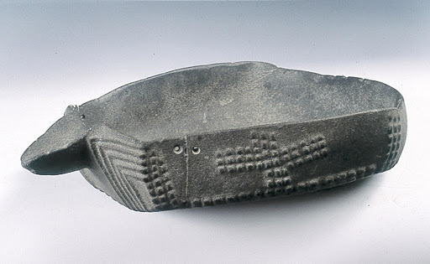
Choirokoitia - tools
Their tools were jewels with stones of various origins.
The human form is dominant on the figurines found in the Neolithic settlement of Choirokoitia. Sharp rings are open rings with a sharp end in the shape of a question mark. Pebbles have a grid with engraved lines. The inhabitants of Choirokoitia, in order to secure their food, were engaged in agriculture, since the location of the settlement made seafood secondary to their diet. Nevertheless, they seem to have used "advanced fishing methods of nets or strong hooks". This can be deduced from the species of fish they caught that were large in size.
Agriculture was based mainly on the cultivation of cereals, legumes and lentils.
At the same time, the inhabitants of the settlement raised in areas outside the village, mainly sheep, goats and pigs.
Finally, deer hunting was carried out by unknown methods. No arrows were found.

Slide 19
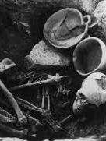
Choirokoitia - tools
The inhabitants of Choirokoitia made tools from different kinds of stone and animal bones.
The tools were used to search for food and process items. Specifically, tools were found for harvesting cereals, processing wood and scraping fresh skins. Most bone tools were used to make objects, including fine sewing threads and drilling tools. Grinding vessels Stationary mills, hammers and a few hammers were found.
Vases: Without a doubt in Choirokoitia several vessels were made of perishable materials, such as wood and leather. It seems that the inhabitants of Choirokoitia made a variety of stone vessels, such as cups, mugs. Many of the vessels are mainly decorated or engraved with geometric shapes, with the sole exception of a vessel that represents a human form.

Slide 20
CHOIROKOITIA - Art
The human figure is the dominant theme of the figurines, a sign that shows similarities with the cultures of the Near East. With the sole exception of a head imprinted in clay, which is on display today at the Cyprus Museum in Nicosia, all the figurines of Choirokoitia are made of stone. Some figures are worked in detail while others are more abstract representations.
Other pieces have been found, more elaborate where they often give a lot of details. The absence of the female figure from the iconography of the Cypriot Neolithic pre-ceramic phase is remarkable, given that in the Middle East, as early as the ninth millennium BC there are plenty of representations of the human form, with a clear priority and preference for the female.

Slide 21
Web sources
Choirokoitia Neolithic Settlement, Larnaca / Αρχαιολογικός Χώρος Χοιροκοιτίας, Λάρνακα – YouTube
(3) Αρχιτεκτονική της Νεολιθικής Χοιροκοιτίας – YouTube

Slide 22
THANK YOU!

Slide 23
GREEN SEEDS
NEOLITHIC ERA
TEAM 4A
ENVIRONMENT AND CLOTHING

Slide 24

CHOIROKOITIA
Choirokoitia is a prehistoric settlement of Cyprus dating back to the Neolithic era.
In 1998 it was declared a World Heritage Site.
This location is approximately in the middle of the road that connects Nicosia with Limassol. It is built on a hill near the river. The people of the Neolithic era are basically different from the people of the Paleolithic, precisely because they cultivated the land and settled in villages.
They provided food for the community by cultivating the land and hunting in the nearby forests. The inhabitants of Choirokoitia had domesticated the sheep, the goat and the pigs. The vessels they patiently made by smoothing the stones of the river.
A high and wide "wall" starts from the beginning of the hill and reaches the top of the settlement. This important building construction was interpreted by its excavator as the main road of the settlement, which made it easier for the inhabitants to move from the highest point of the hill to the bottom of the river.

Slide 25
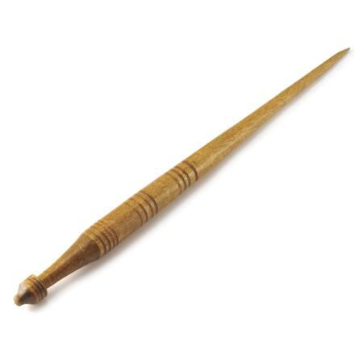
Clothing Spindle
Their clothes were made mainly of animal skin and wool.
The spindle is a wooden tool with which the ancients sewed the sheep's wool and created clothes.

Slide 26
Homes in Choirokoitia, The dead
In Choirokoitia the houses are small and built on both sides of the road.
The houses were made of clay on a solid base of stones.
The dead were buried inside the house with many tributes, ornaments and tools the women had. The place and position of some women as well as the ritual breaking of vessels in their graves show that there were women with an important position in the community.

Slide 27
Web sources
Choirokoitia Neolithic Settlement, Larnaca / Αρχαιολογικός Χώρος Χοιροκοιτίας, Λάρνακα – YouTube
(3) Αρχιτεκτονική της Νεολιθικής Χοιροκοιτίας – YouTube Architecture in Choirokoitia

Slide 28
Green seeds:Neolithic era environment and clothing
TEAM 4B
Maria Xatzigeorgiou

Slide 29
What did they wear and how did they make it?
In the Neolithic Times people dressed in what they found in nature.
Their clothes were made of animal wool while for their sewing they used the spindle, a wooden pointed tool.
Their first creation was the fabric that had entered their lives for good!
Their first constructions were: the hat, leather sandals and dresses.
As for the jewelry, the ancient Cypriots made many necklaces and bracelets from shells and animal teeth.

Slide 30
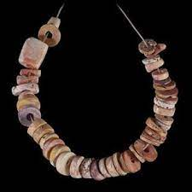
MEANING OF CLOTHING
Sometimes the ancients, because they still believed in idols and magic,
believed that an ornament of theirs could have religious value or magical powers.
In addition, those who wore part of an animal's body believed that they were gaining strength at the same time.

Slide 31
VIDEOS-links
https://www.youtube.com/watch?v=V03lhYLUr5E&t=408s
https://www.youtube.com/watch?v=W0R7eisl-S0&t=1700s

Slide 32
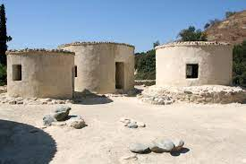
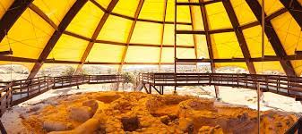
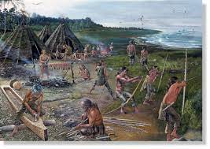

Slide 33
THANK YOU ☺

Slide 34
GREEN SEEDS ☺
Topic: Choirokoitia-
Environment and Diet.
TEAM 5
Andri and Foteini !
Notes:
34

Slide 35
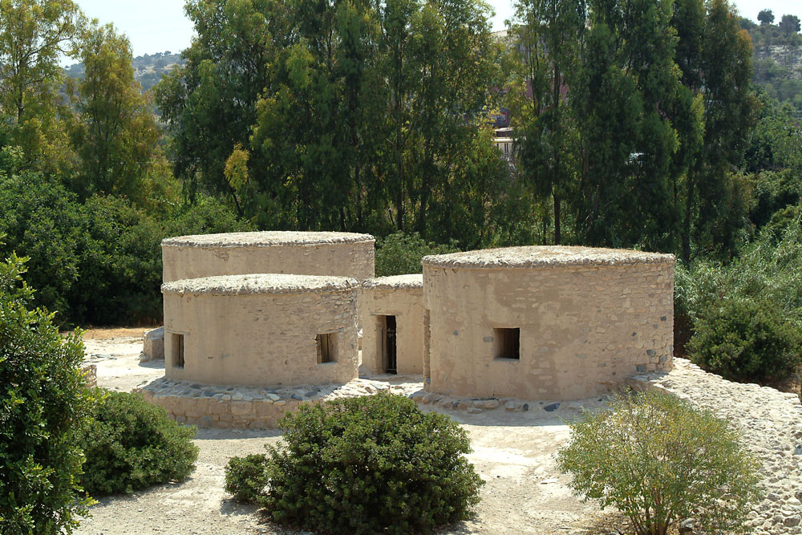
CHOIROKOITIA- WHERE THEY LIVED
35
4/22/2021
Add a footer

Slide 36
ENVIRONMENT AND DIET
WHAT THEY USED TO EAT:
They cultivated wheat, even to a limited extent they cultivated barley and finally legumes such as lentils.
Their diet included fruits that they picked from wild trees such as pistachios, figs, olives and plums.
Their territory
We believe that they lived in a fertile environment, where they had several food options! Since they always took care to build their houses on hills to protect themselves from any enemies.
36
4/22/2021
Add a footer

Slide 37
DIETARY CHOICES
The products they produced
The plants that usually thrived in Choirokoitia were trees such as olives, figs and plants. Therefore, they fed on olives, figs and some of the plants in their food.
Their creative pursuits
• Agriculture (based mainly on the cultivation of cereals)
• Livestock-Hunting (Based on deer, sheep, goats and pigs)
37
4/22/2021
Add a footer

Slide 38
Web sources
Choirokoitia Neolithic Settlement, Larnaca / Αρχαιολογικός Χώρος Χοιροκοιτίας, Λάρνακα – YouTube
(3) Αρχιτεκτονική της Νεολιθικής Χοιροκοιτίας – YouTube

Slide 39
Thank you Green Seeds ☺

